Slide 1
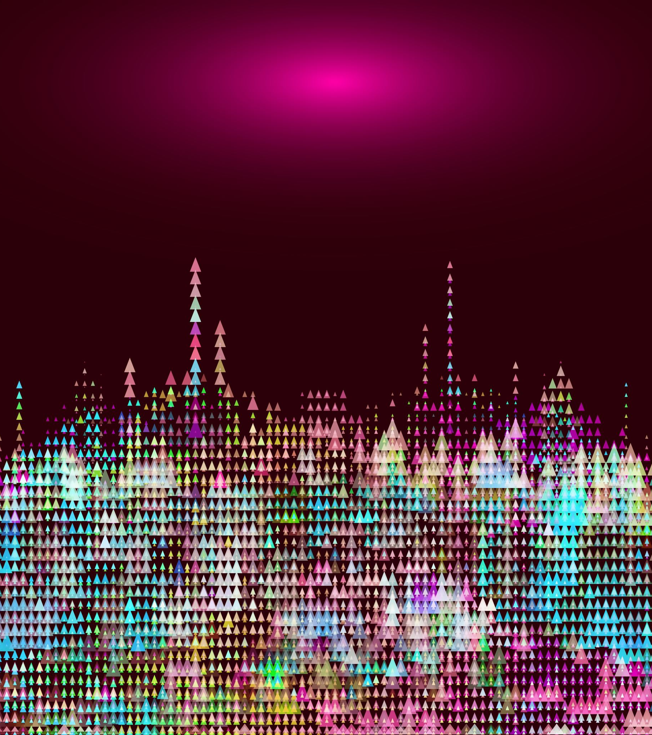
Pixel Legends
2D Project by Ivan & Ehsan

Slide 2
1.Players
This is our single player game in 2D design based on “Super Mario” style. The game is very simple and basic but I think that makes it special. The character in our game is called “Pink Guy”.

Slide 3
2.Objective
The objective of the game is for our character “Pink Guy” to pass through all dangerous challenges and reach the end of the map which will lead him to another level.

Slide 4
3.Design
The design as we have already mentioned is very simple and this is to keep the clean design of the game and it gives that eye-popping experience.

Slide 5
4. Coding
The coding was basic but hard for beginners like us. I would say someone with more experience will have done the project a lot quicker for what it is.

Slide 6
5.Improvements
I think this game can be taken to another level if we do more levels and add more challenges with character fighting for example or some kind of buildings which lead to another maps, something like “side quests”

Slide 7
WHAT WE LEARNED
I think working through Unity really helped us understand the software a bit more and after using it for some time it became a bit more understandable and easier to work with. I think for future uses it will be easier for us to complete any projects and the time will be reduced depending on the project itself.

Slide 8
Questions?
This is the time for anyone who is interested in our game to ask any questions ☺

